Slide 1

BOOK YOUR SHOW
Designed by :Sandeep&Team
CSE-(DS&AI)-B
PROJECT-DS

Slide 2
1
ABSTRACT
The BOOK YOUR SHOWproject is an innovative web application designed to streamline the movie booking process, offering users a seamless experience from selecting movies to making secure payments. The project leverages HTML, CSS, and JavaScript to create an engaging and user-friendly interface.
PROJECT-DS

Slide 3
2
Technology Stack:
Frontend: HTML, CSS, JavaScript
Additional Libraries: Google Fonts API
Frameworks: javascript
Integration: Local Storage for data persistence like web SQL
PROJECT-DS

Slide 4
CSS
HTML
Cascading Style Sheets (CSS) is a style sheet language used for specifying the presentation and styling of a document written in a markup language such as HTML or XML (including XML dialects such as SVG, MathML or XHTML).CSS is a cornerstone technology of the World Wide Web, alongside HTML and JavaScript.
Web browsers receive HTML documents from a web server or from local storage and render the documents into multimedia web pages. HTML describes the structure of a web page semantically and originally included cues for its appearance.
PROJECT-DS

Slide 5
3
KEY FEATURES:
Interactive Movie Selection
Seat Reservation System
User-Friendly Forms
Payment Integration
Ticket Print
PROJECT-DS

Slide 6
4
MOVIE DISPLAY PAGE
Interactive Movie Selection: Users can explore a variety of movies presented in an appealing card layout. The use of JavaScript enables dynamic interactions, allowing users to click on movie cards to view details and proceed with bookings.
PROJECT-DS

Slide 7
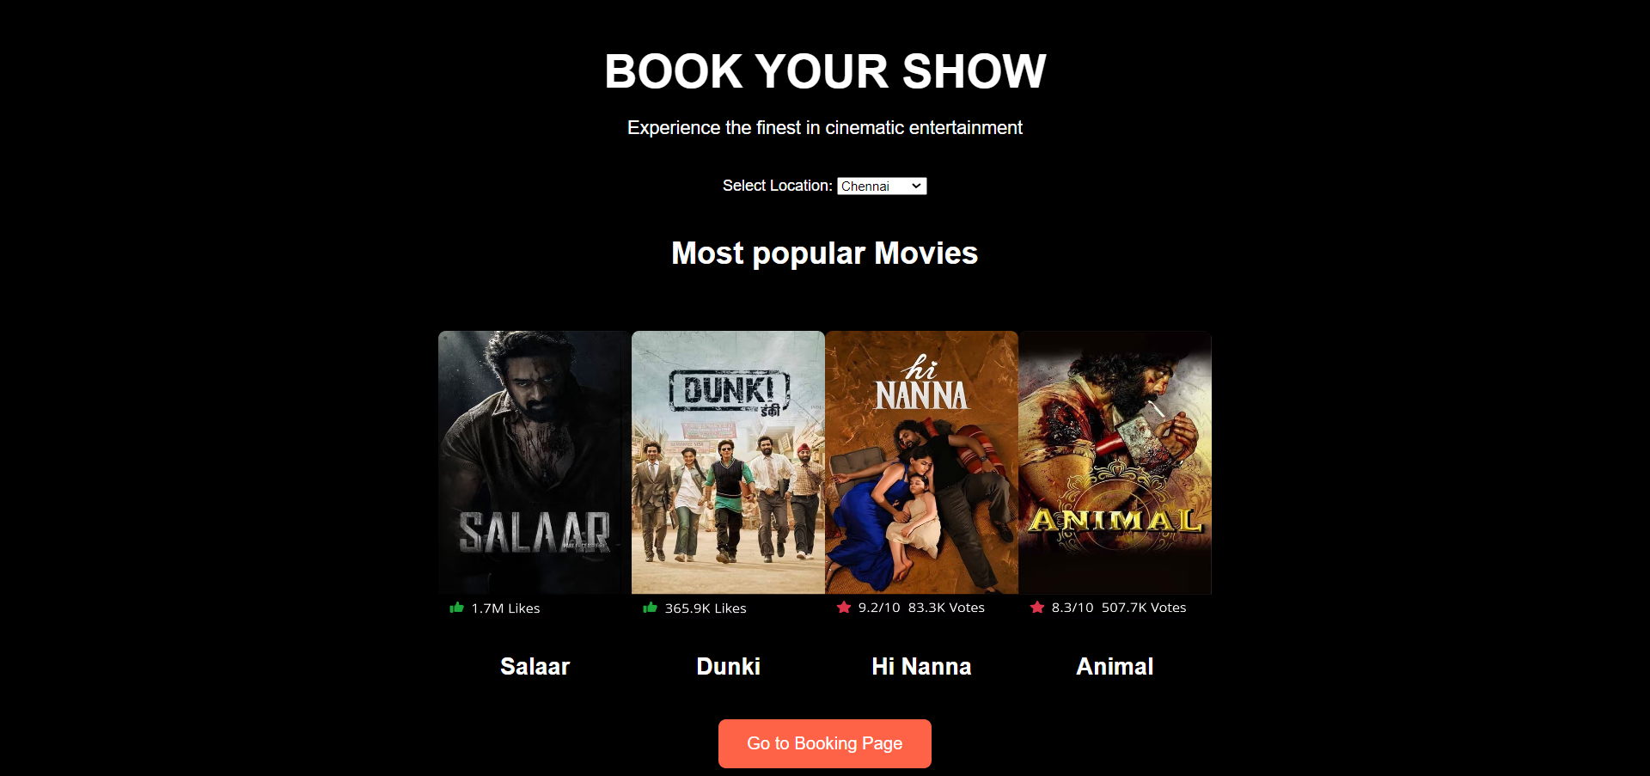

Slide 8
6
SEAT RESERVATION SYSTEM
Seat Reservation System: The application incorporates an interactive seat reservation system with a visually appealing representation of available, selected, and sold seats. JavaScript is employed to manage seat selection and update the total cost dynamically.
PROJECT-DS

Slide 9
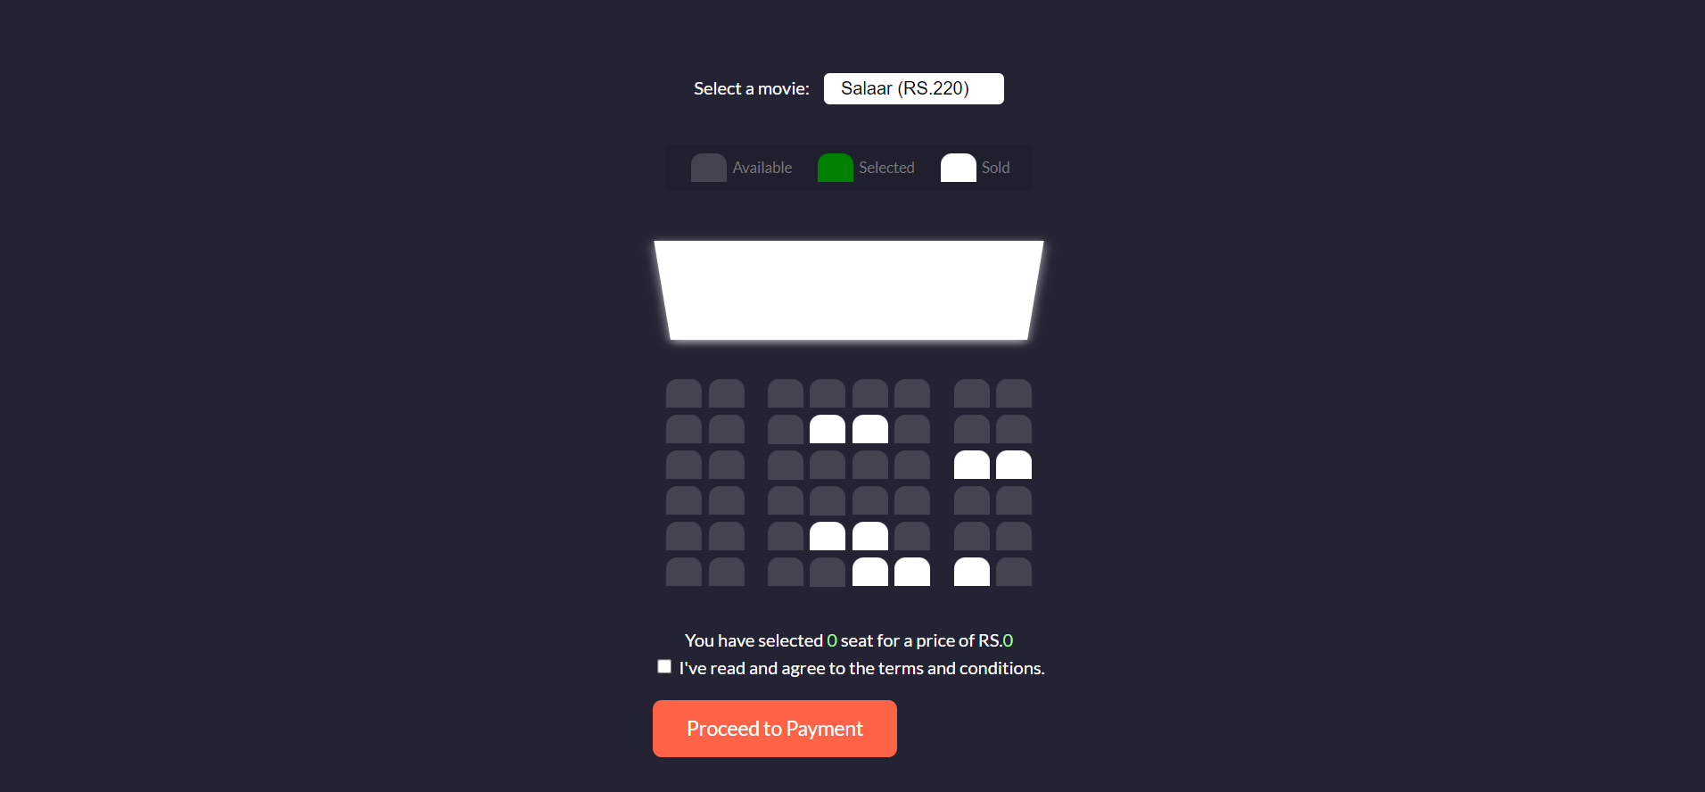

Slide 10
8
USER-FRIENDLY FORMS
User-Friendly Forms: The project includes well-designed forms for user input, ensuring a smooth booking process. JavaScript validates and processes user data, providing a robust and secure booking experience.
PROJECT-DS

Slide 11
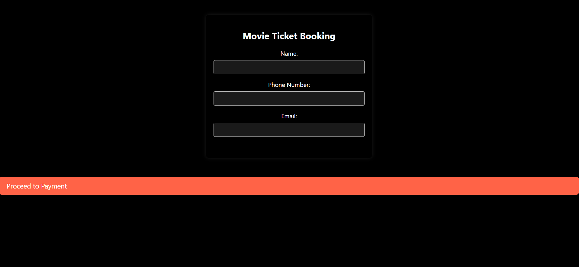

Slide 12
14
PAYMENT INTEGRATION
Payment Integration: Users can seamlessly proceed to the payment stage, with JavaScript facilitating a visually engaging payment button that animates upon interaction. The application supports the simulation of a payment process.
PROJECT-DS

Slide 13
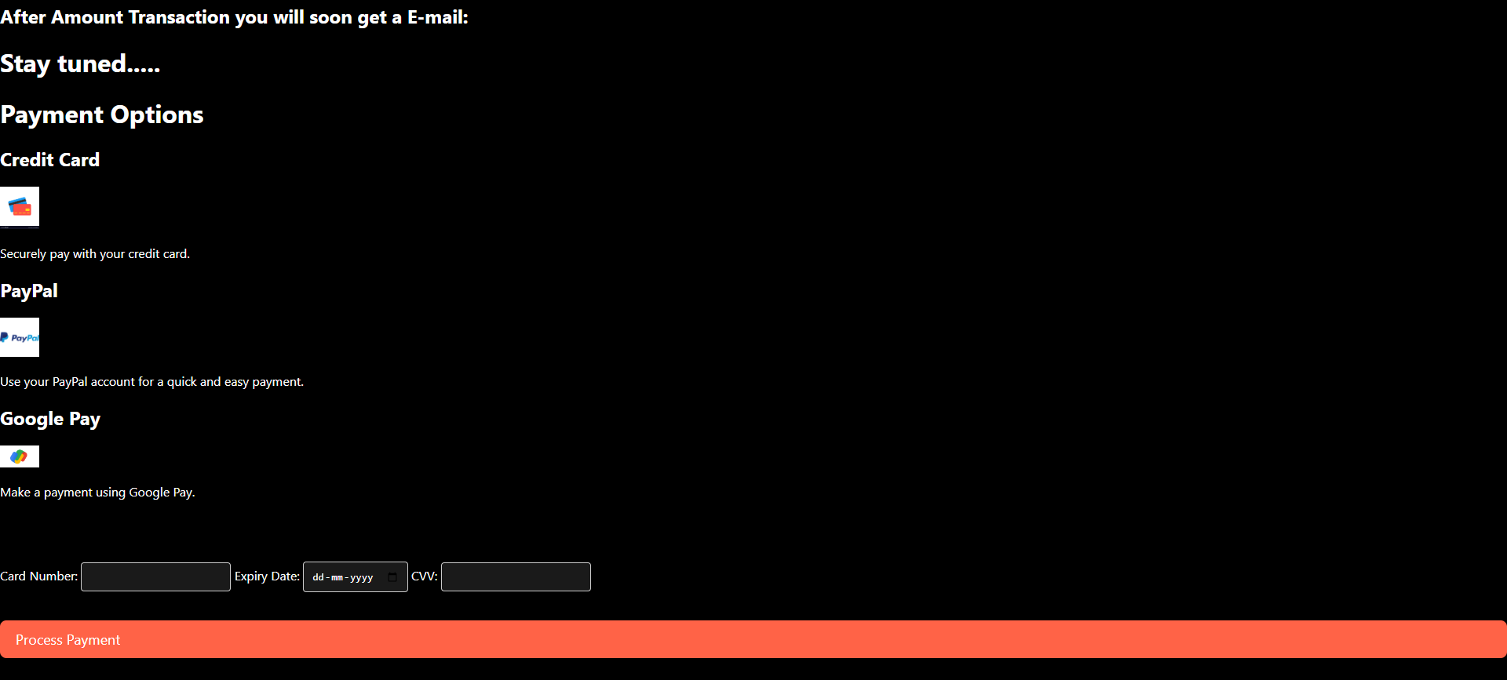

Slide 14
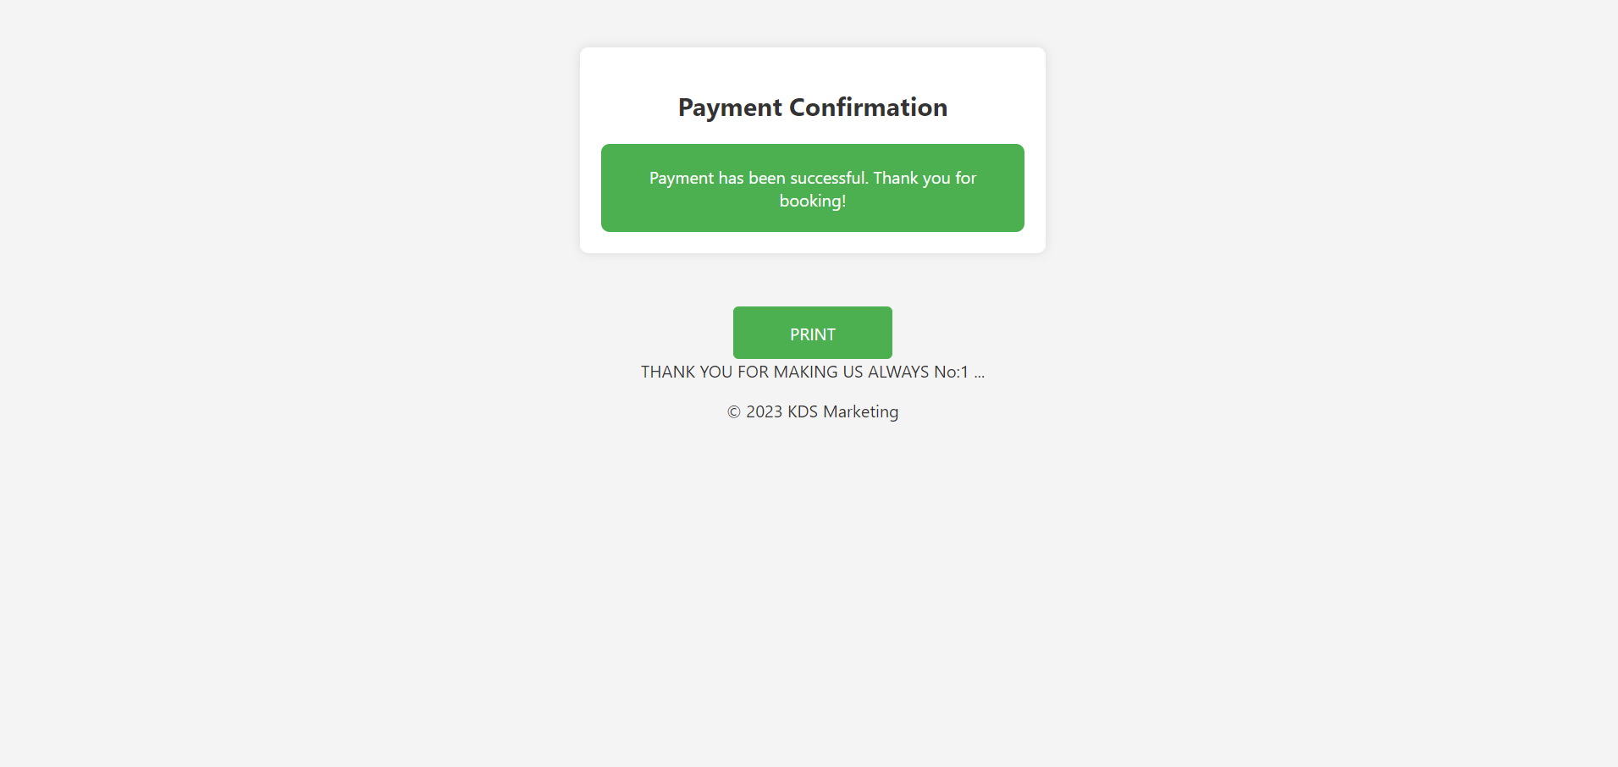

Slide 15
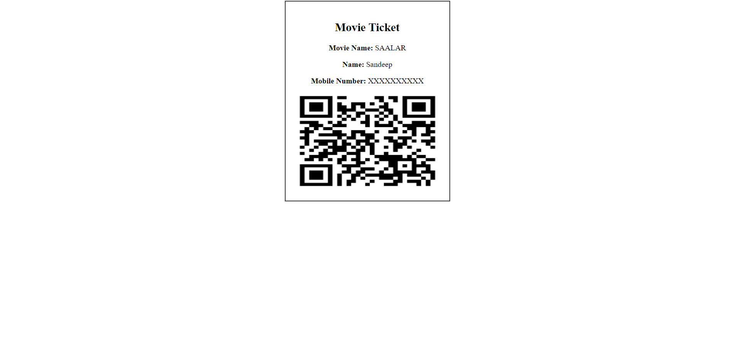

Slide 16

12
CONCLUSION
BOOK YOUR SHOW showcases the effective integration of front-end technologies to create a visually appealing and functional movie booking platform. The project employs responsive design principles, making it accessible across devices. The use of JavaScript enhances user interactivity, creating a dynamic and engaging user experience.
PROJECT-DS

Slide 17
THANK YOU
PROJECT-DS

